Slide 1
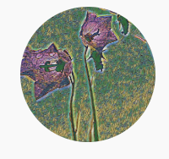
Problems on Counting

Slide 2
Reference
Data
Youtube
Code

Slide 3
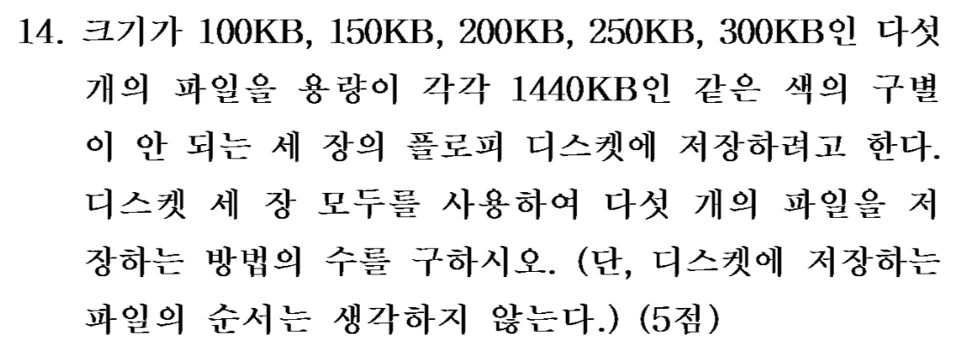
[2002]

Slide 4
[2002]

Slide 5
First,
we assume
all three disks are distinct,
call them a, b, c.

Slide 6
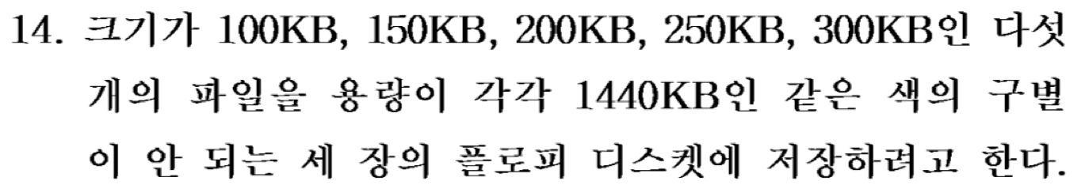

Slide 7
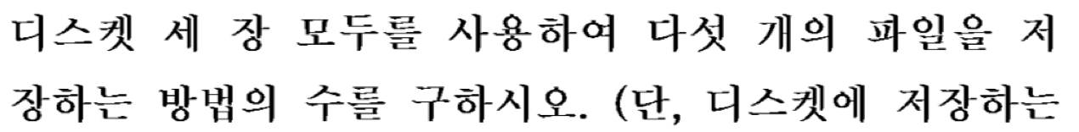

Slide 8


Slide 9
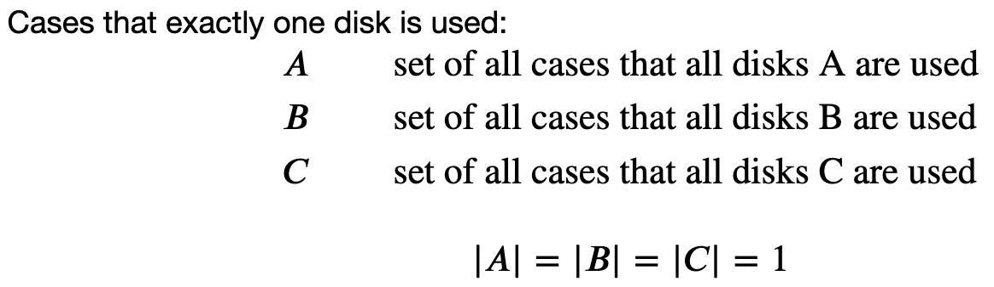


Slide 14
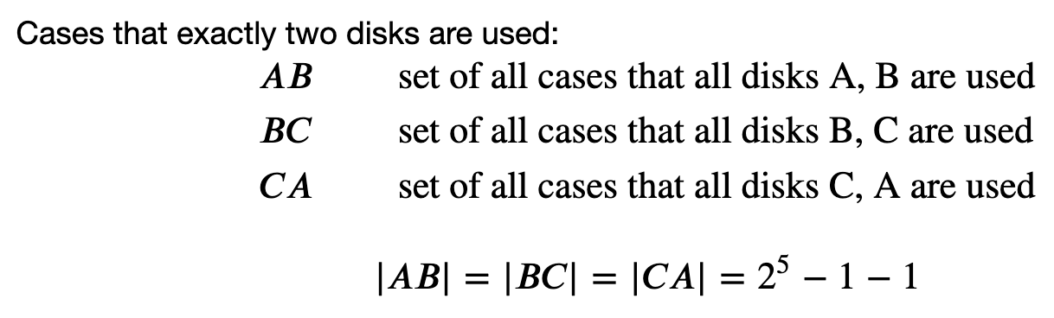

Slide 19
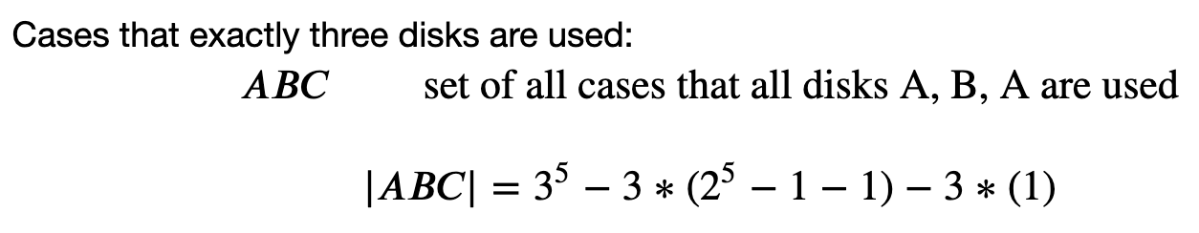

Slide 22
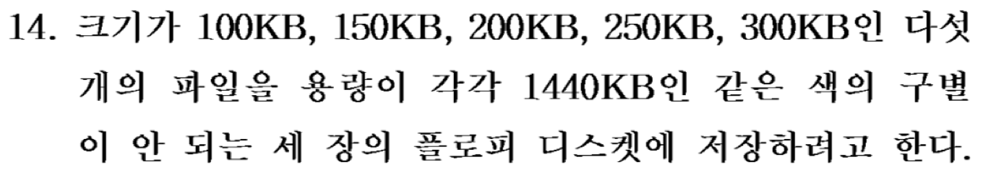

Slide 23
Now,
we assume
all three disks are indistinguishable.

Slide 24
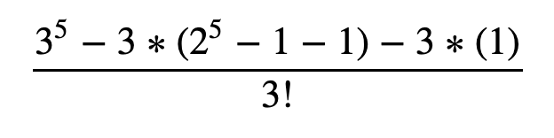

Slide 25
